Slide 1
Spring Framework Annotations

Slide 2
Spring
Request Responses
@GetMapping
@RequestMapping
@RequestParam

Slide 3
Spring
Component Types
@Component
@Service
@Repository
@Controller
@RestController

Slide 4
Spring
Testing
@SpringBootTest
@MockBean
@Validated
Misc
@Bean
@ConditionalOnJava

Slide 5
Request Responses
@GetMapping
@GetMapping annotation maps HTTP GET requests onto specific handler methods
It is a composed annotation that acts as a shortcut for @RequestMapping(method = RequestMethod.GET)

Slide 6
@ GetMapping
Look at your earlier Hello World and get it returning a response
In this example, again from Spring’s demo code, the @GetMapping class combines with the @RestController to deliver a response to calls like http://yoururl/hello.
Here, it’s a simple Hello World by default, though it also shows how to take a parameter, which can replace the default World in the response. http://yoururl/?name=Nancy will return Hello Nancy, for example.

Slide 7
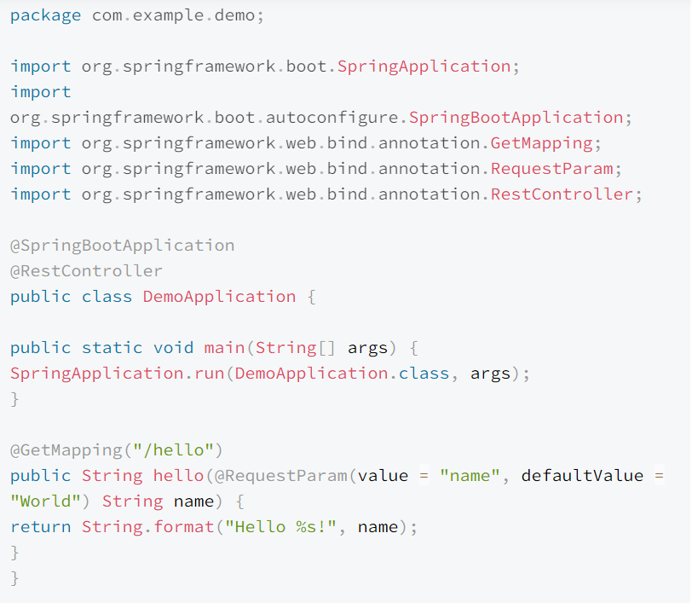
@ GetMapping Example

Slide 8
@RequestMapping
@RequestMapping is the most common and widely used annotation in Spring MVC. It is used to map web requests onto specific handler classes and/or handler methods.
@RequestMapping can be applied to the controller class as well as methods.
This annotation can be combined with @Controller to create a class that returns simple requests.

Slide 9
@ RequestMapping
@Controller
@RequestMapping("users")
public class UserController {
@GetMapping("/{id}", produces = "application/json")
public @ResponseBody User getUser(@PathVariable int id) {
return findUsersById(id);
}
private User findUsersById(int id) {
// return user specific data
}

Slide 10
@RequestParam
@RequestParam is a Spring annotation used to bind a web request parameter to a method parameter.
It has the following optional elements: defaultValue - used as a fallback when the request parameter is not provided or has an empty value. name - name of the request parameter to bind to.

Slide 11
@component
@Component is a class-level annotation.
It is used to denote a class as a Component.
We can use @Component across the application to mark the beans as Spring’s managed components.

Slide 12
@component
Spring framework provides three other specific annotations to be used when marking a class as a Component.
@Service
@Repository
@Controller

Slide 13
@component
@Service
This is an alternative to @Component that specifies you intend to use the class as part of your service layer.
However, it doesn’t actually implement anything differently than @Component.

Slide 14
@component
@Repository
We specify a class with @Repository to indicate that they’re dealing with CRUD operations, usually, it’s used with DAO (Data Access Object) or Repository implementations that deal with database tables.

Slide 15
@component
@ Controller
We specify a class with @Controller to indicate that they’re front controllers and responsible to handle user requests and return the appropriate response. It is mostly used with REST Web Services.

Slide 16
@RestController
@RestController combines the @Controller and @ResponseBody into a single annotation.
@RestController classes return domains instead of views.

Slide 17
Testing
@SpringBootTest
Spring Boot provides a @SpringBootTest annotation, which can be used as an alternative to the standard spring-test @ContextConfiguration annotation when you need Spring Boot features.
The annotation works by creating the ApplicationContext used in your tests through SpringApplication .
You can mark a test class as follows:
@SpringBootTest(properties = "spring.main.web-application-type=reactive")
class YourTests {
// code here
}

Slide 18
Testing
@MockBean
The @MockBean annotation allows you to create a temporary version of a service for testing.
It’s useful if you have a web service you connect to that isn’t suitable for testing, or if you want to test against specific results.

Slide 19
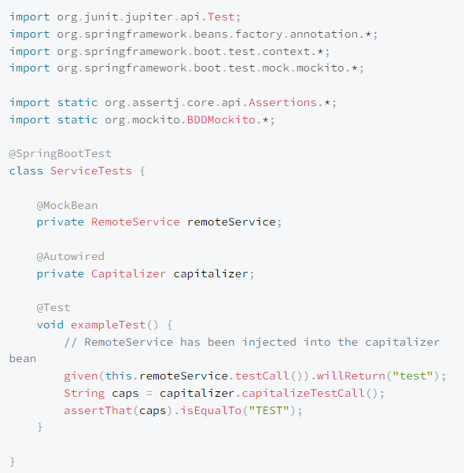
@MockBean Example

Slide 20
Testing
@Validated
To validate input for methods, you apply the @Validated annotation to the class. For nested properties, apply the @Valid tag.

Slide 21
@ Validated Example
import javax.validation.constraints.Size;
import javax.validation.constraints.NotNull;
import org.springframework.stereotype.Service;
import org.springframework.validation.annotation.Validated;
@Service
@Validated
public class TestBean {
public Archive findByCopiesAndTitle(@Size(min = 1, max = 100) String code, @NotNull Title title) {
return …
}
}

Slide 22
@Bean
Dependency Injection is central to Spring Boot, and the @Bean annotation allows you to mark tightly coupled classes. That tells the Spring container to handle their lifecycle.
@Bean is a method-level annotation

Slide 23
Misc
@ConditionalOnJava
If you want code to run only on a particular Java version, this annotation is very handy.
@Service
@ConditionalOnJava(JavaVersion.EIGHT)
Class UserAlertService {
// strongly suggest a Java update
...
}

Slide 24
Spring Annotations
The End

